Slide 1

ICT Academy of Kerala
Building the Nation’s Future
Machine Learning, AI & Generative AI

Slide 2
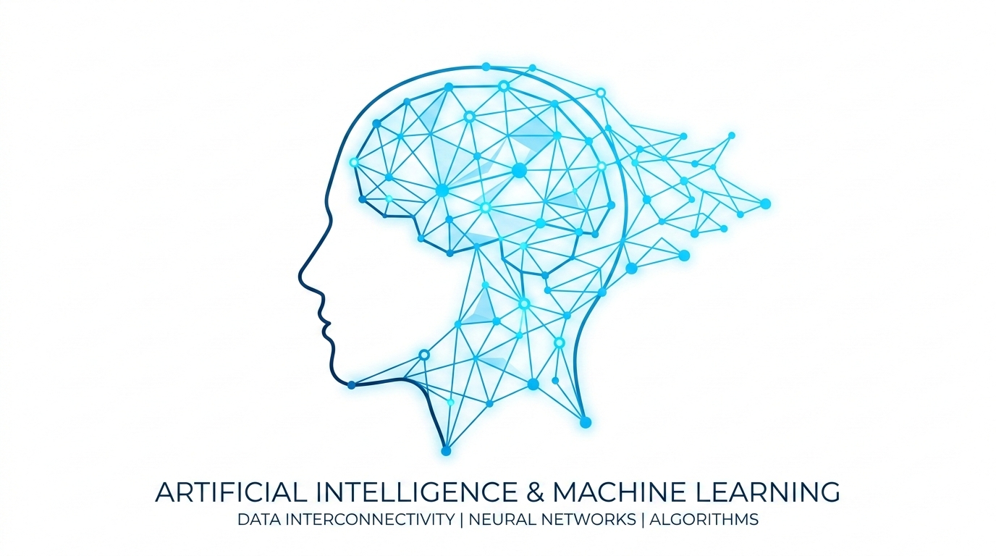
Knowledge Office
Machine Learning, AI & Generative AI
Trends | Industry Use Cases

Slide 3
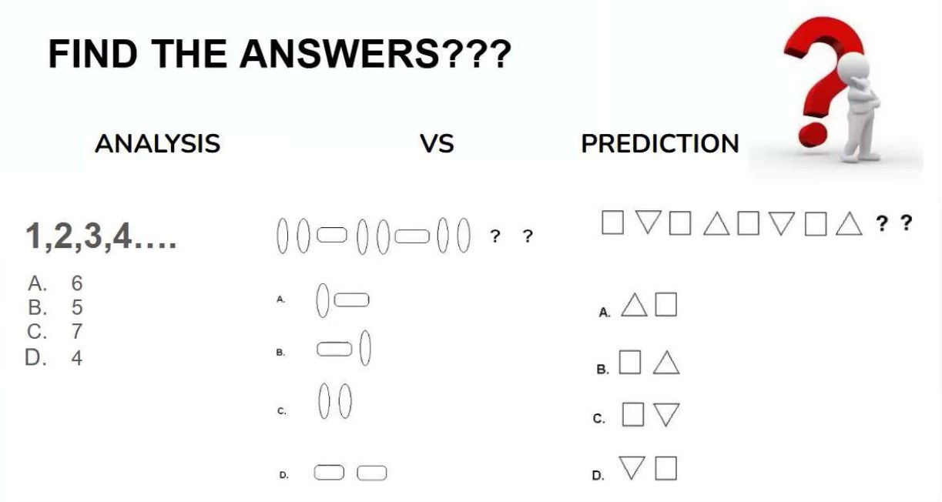
Knowledge Office
Analysis vs Prediction
Analysis: understand what already happened (sales last month)
Prediction: estimate what will happen (sales next month)
Number series 1,2,3,4,… → 5 is a prediction from a pattern
Humans find patterns in shapes and numbers; ML does it at scale
Notes:
Run the pattern puzzles (numbers and shapes) from the earlier deck as a quick poll.

Slide 4

Knowledge Office
Learning from Past Experience
The Foundation of AI Training
"This human process of learning from past experiences and performing in-depth analysis to make predictions is the exact foundation of how AI models are trained to find patterns."
Exam Preparation
We analyze past question papers and look at historical data to find answers and predict future questions.
Human Intelligence → Machine Learning
Both systems rely on recognizing historical patterns to solve new problems effectively.

Slide 5

Knowledge Office
How Humans and Computers Learn and Predict
The Human Approach
We learn automatically from our daily experiences and interactions to find answers and make predictions.
The Machine Approach
Computers achieve this through data. They learn from past data with the help of Machine Learning to formulate predictions.

Slide 6
Knowledge Office
What is Data?
Data consists of raw facts about the world. It can be represented in various formats, including numbers, text, images, audio, and video.
Examples of Data:
Weather data
Customer details
Cricket scores
A Potato
Weather Data
284/4
Customer Details
Cricket Scores

Slide 7
Knowledge Office
From Data to Intelligence
The progression from raw inputs to actionable decisions follows a specific sequence:
1
2
3
4
Data
Raw facts
Information
Organized data
Knowledge
Meaningful insights
Intelligence
Better decisions

Slide 8
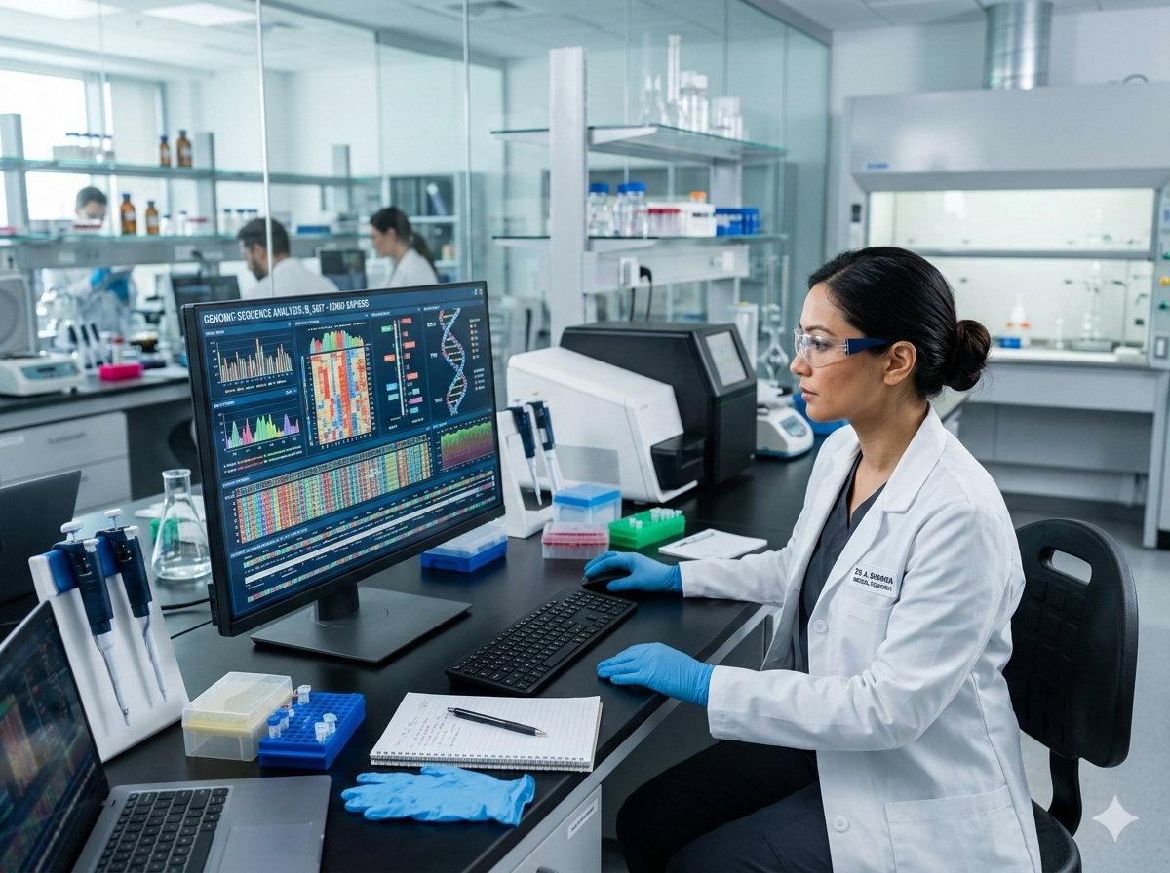
Knowledge Office
Healthcare Applications: Transforming Medicine
Artificial Intelligence is heavily utilized in the healthcare sector to process complex biological data and improve patient outcomes. Key applications include:
Genetics & Genomics
Analyzing DNA sequences to understand genetic conditions.
Drug Discovery
Accelerating the research and development of new pharmaceuticals.
Image Analysis
Enhancing the accuracy of medical imaging and diagnostics.

Slide 9
Knowledge Office
Finance & Enterprise Applications
Beyond healthcare, AI powers critical enterprise and financial operations by handling vast amounts of information and identifying anomalies. Key areas include:
Risk Analytics
Evaluating and mitigating financial risks.
Fraud Detection
Identifying suspicious activities in real-time.
Algorithmic Trading
Executing automated, high-frequency trades.
Data Management & CRM
Managing customer data effectively.

Slide 10
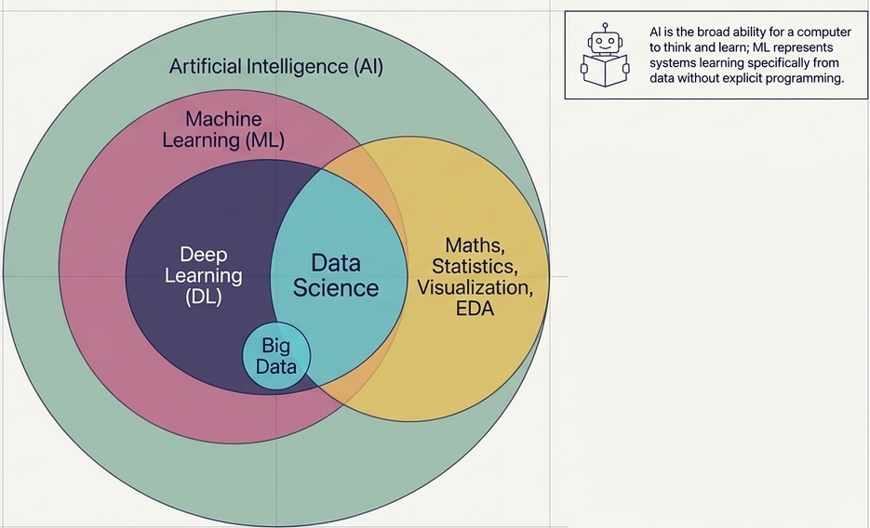
Knowledge Office
AI, ML, DL & Data Science

Slide 11
Knowledge Office
Defining the field: AI, ML, DL, Data Science
AI: machines that think and learn (broadest umbrella)
ML: subset of AI that learns from data without explicit programming
Deep Learning: ML using multi-layer neural networks
Data Science: extracts insight from data using statistics, ML, visualization
Generative AI: DL models that create new text, images, code, audio
Notes:
Draw the nested circles: AI > ML > DL > GenAI, with Data Science overlapping ML.

Slide 12
Knowledge Office
What is Artificial Intelligence (AI)?
"Artificial Intelligence refers to machines or systems that can perform tasks that normally require human intelligence."
Key capabilities of AI systems:
Understand
Process sensory inputs & data
Reason
Logical thinking & analysis
Learn
Adapt from patterns & experience
Make Decisions
Evaluate options & act
Solve Problems
Find optimal solutions

Slide 13
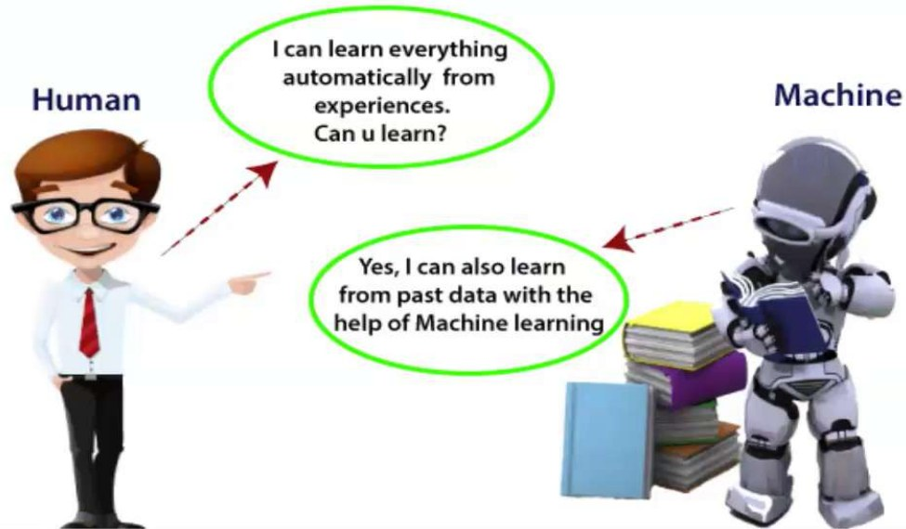
Knowledge Office
Machine Learning in one picture
Human learns from experience; machine learns from past data
Algorithms identify patterns, then improve with more data
Traditional code: rules + data → answers
ML: data + answers → rules (the model)
Notes:
Contrast programming vs learning.

Slide 14
Knowledge Office
Types of Machine Learning
Supervised Learning
Uses labeled data (known output).
Unsupervised Learning
Uses unlabeled data (find patterns).
Semi-Supervised Learning
Uses a combination of labeled & unlabeled data.
Reinforcement Learning
Learns from rewards & penalties.

Slide 15
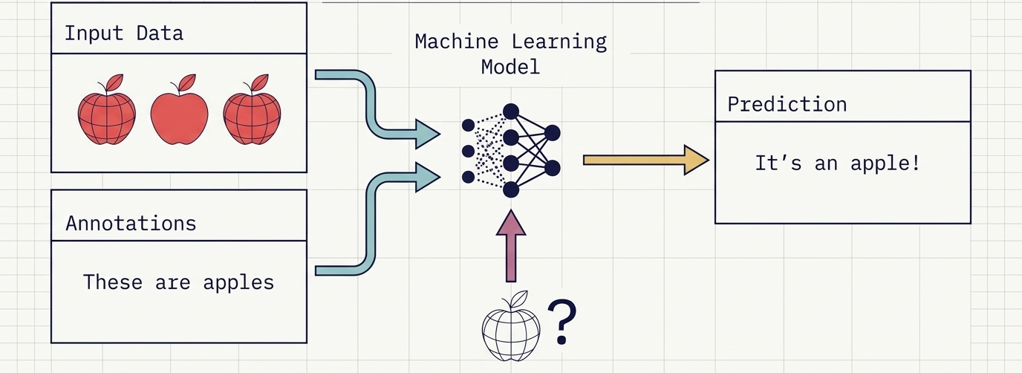
Knowledge Office
Supervised learning
Input data + annotations ("these are apples") → trained model
Predicts labels for new data: "it's an apple"
Classification: spam vs not spam, face unlock, scam alerts
Regression: house price, stock trend, temperature
Notes:
Examples in class: Face lock screen, spam filter, handwriting recognition, scam detection.

Slide 16
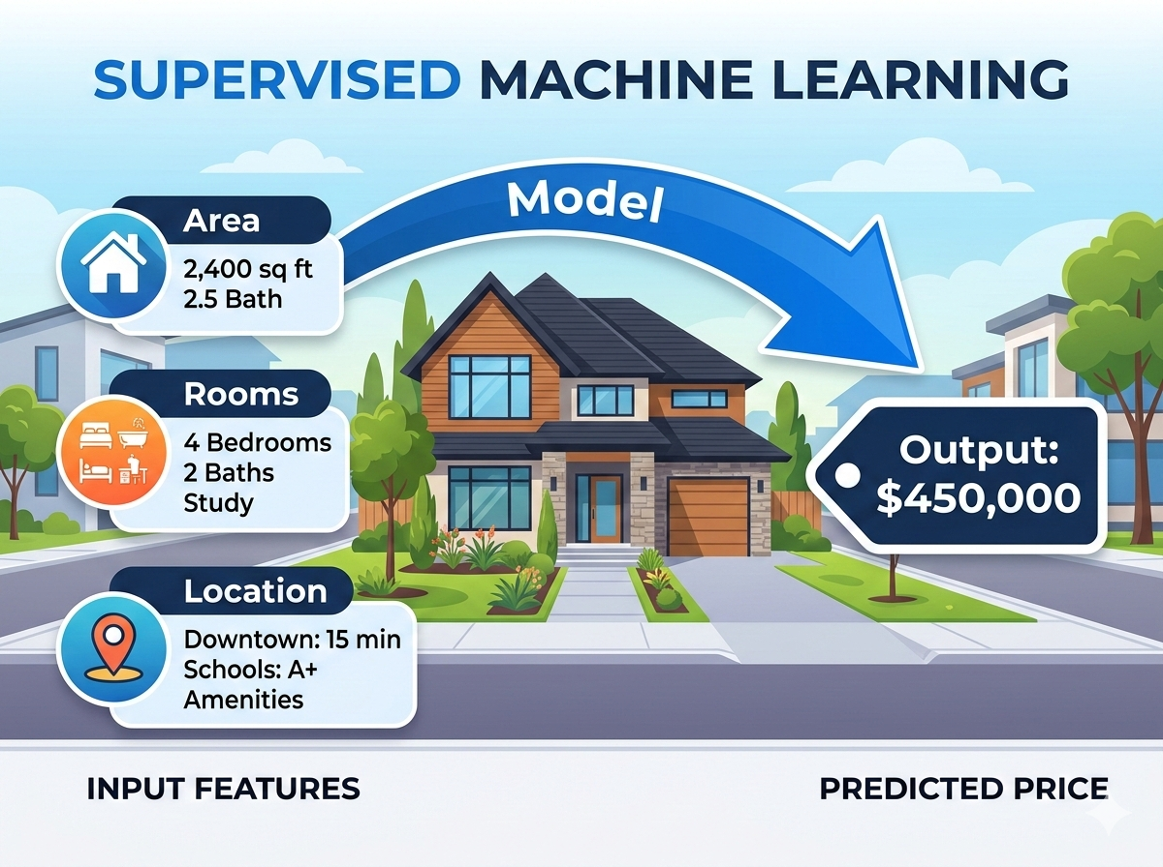
Knowledge Office
Supervised Learning
Supervised Learning uses labeled data containing both the input and the output. The system learns a mapping function to connect the two.
Examples:
House price prediction
Disease prediction
Spam detection

Slide 17
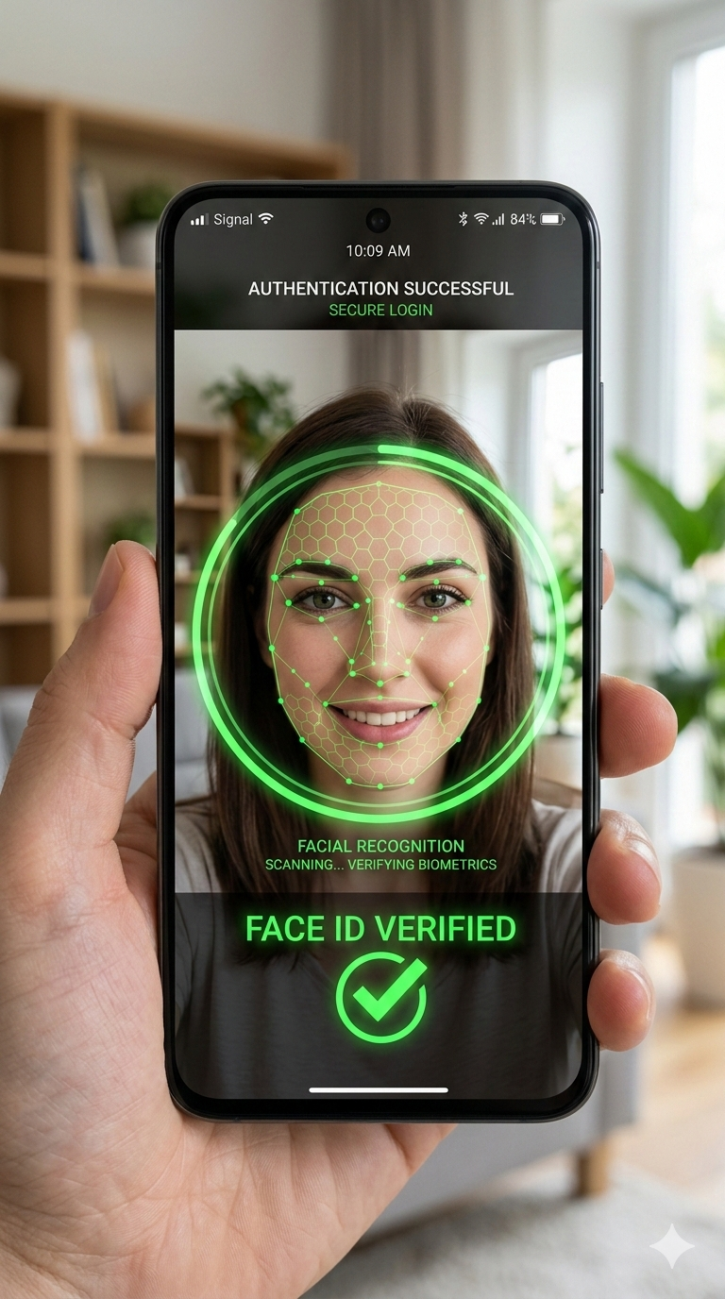
Knowledge Office
Supervised ML Applications
Supervised learning powers everyday security and communication tools by recognizing known patterns:
Biometric Authentication
Face Lock Screen
Communication Security
Spam and Scam Alerts
Used in devices like the Galaxy S22 Ultra to authenticate users based on labeled facial data.
Supervised Pattern
Maps pixel facial features to verified user identity labels.
Classifying incoming messages as safe or malicious based on previously identified spam patterns.
Security Alert Resolved
Your password was updated...
SAFE
URGENT: Claim $10,000
Click link immediately to verify...
SPAM

Slide 18
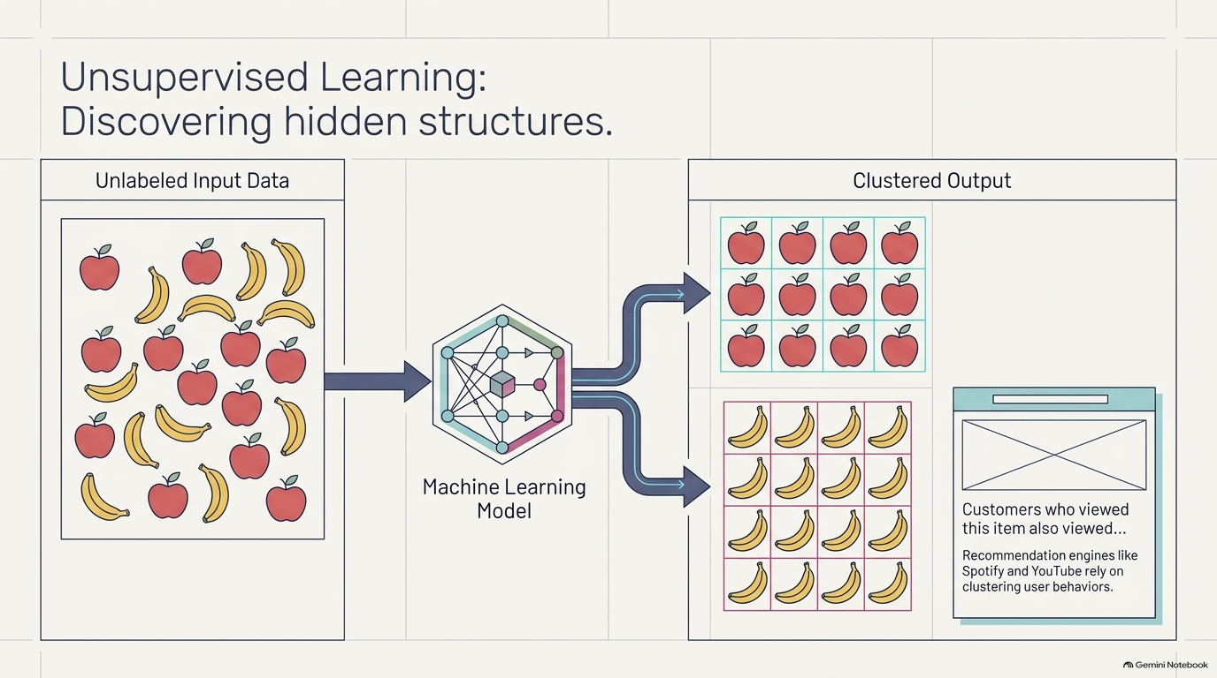
Knowledge Office
Unsupervised learning
No labels: model groups similar items (clustering)
Fruit basket separated into apples, oranges, bananas
Recommendations: "Customers who viewed this also viewed"
Spotify playlists, YouTube suggestions, customer segmentation
Notes:
Ask: how does Spotify know your taste without labels?

Slide 19



Knowledge Office
Unsupervised Learning: Finding Hidden Groups
Amazon-style recommendations
Spotify playlists
YouTube suggestions
'Customers who viewed this also viewed': groups of similar buyers and items.
Clusters listeners and songs by taste.
Groups similar videos and viewers.
No labels given: the model discovers structure by itself (clustering).
Notes:
Mixed apples, oranges and bananas get grouped with no labels. Customers who viewed this also viewed = recommendation.

Slide 20
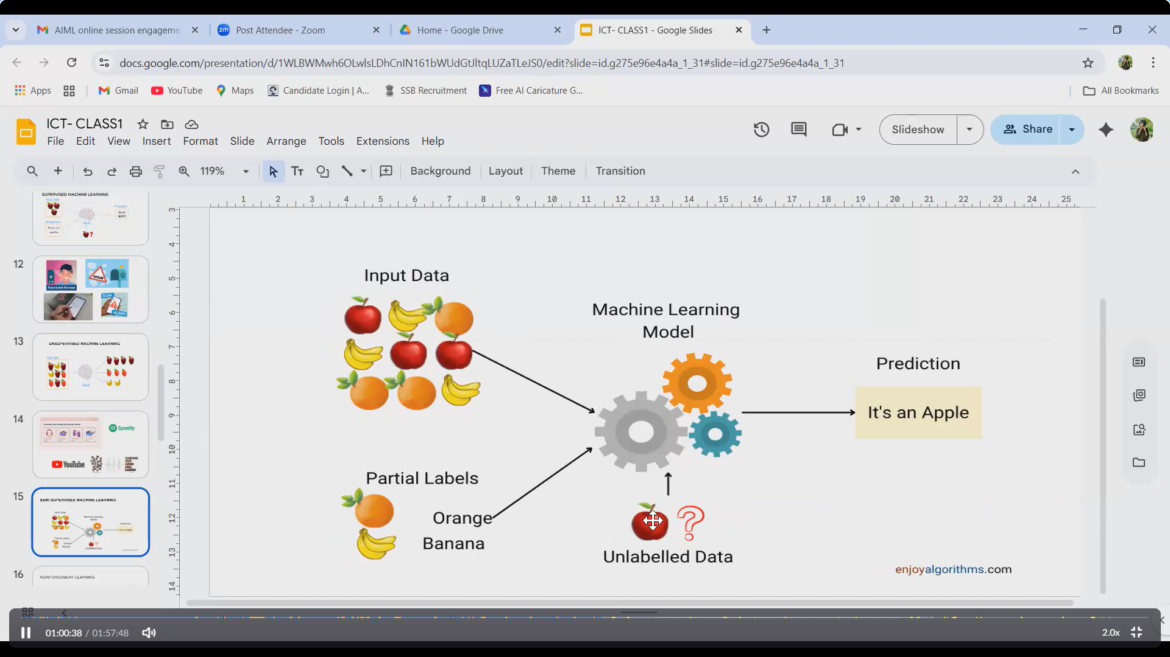
Knowledge Office
Semi-Supervised Learning
Semi-Supervised Learning uses a small amount of labeled data and a large amount of unlabeled data. This approach is highly useful when labeling data is costly or time-consuming.
Examples:
Image recognition
Medical data

Slide 21
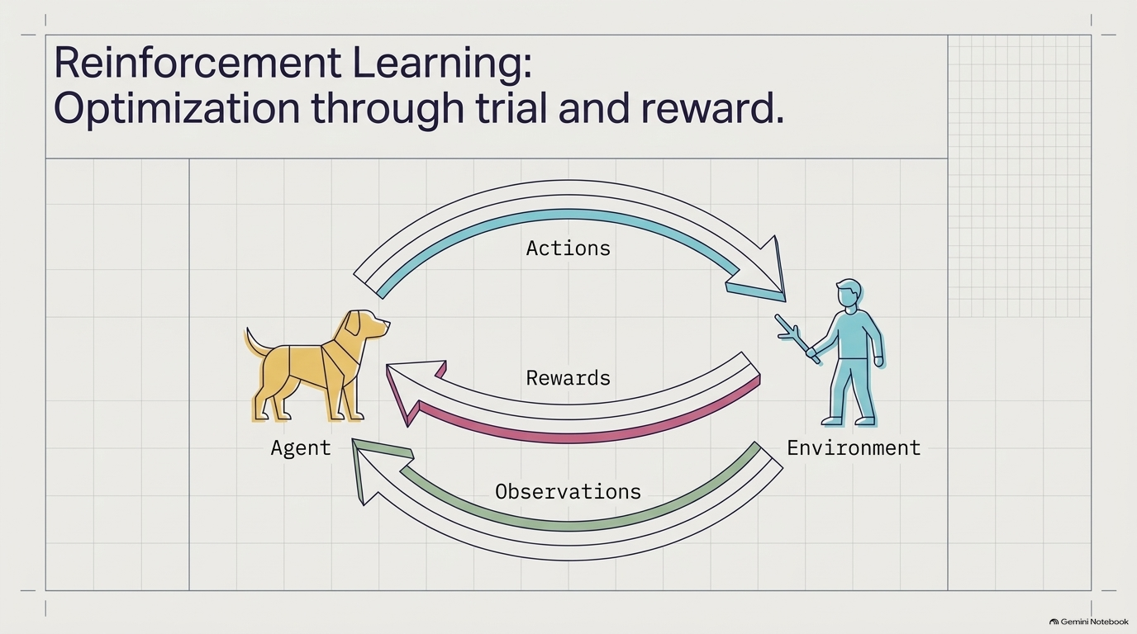
Knowledge Office
Reinforcement learning
Agent takes actions in an environment and gets rewards
Dog training: treat for good behavior, nothing for bad
AlphaGo beat Lee Sedol (2016); chess engines; robotics
Also: self-driving cars, game AI, ad bidding
Notes:
Draw the agent / action / reward / observation loop.

Slide 22
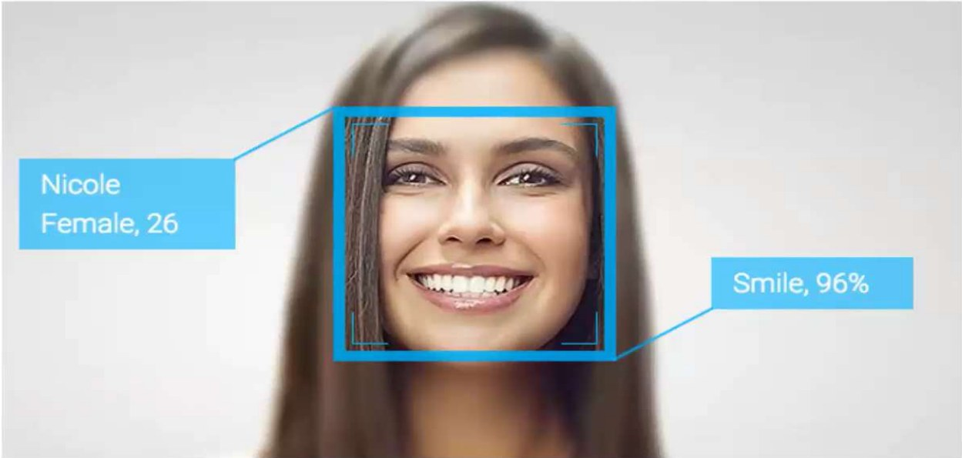
Knowledge Office
Deep learning
Neural networks with many layers learn features automatically
Powers face detection, speech recognition, translation
Face analysis example: age, gender, smile detection from pixels
Needs lots of data and compute (GPUs)
Notes:
Bridge into generative AI: transformers are a deep learning architecture.

Slide 23



Knowledge Office
Deep Learning: Neural Networks at Scale
Computer vision
Language (NLP)
Autonomy
Face detection, age and emotion estimation, medical imaging.
Translation, chatbots, summarization.
Self-driving cars, drones.
Many-layered neural networks learn features automatically
Needs lots of data and compute (GPUs)

Slide 24
Knowledge Office
Data Science Lifecycle
The Data Science Lifecycle is a structured, step-by-step process:
01
02
03
04
05
06
07
Business Understanding
Define objectives, identify stakeholders, and frame the problem statement.
Data Collection
Gather raw data from APIs, databases, web scraping, or logs.
Data Cleaning
Handle missing values, remove noise, and standardize formats.
Exploratory Data Analysis
Discover patterns, anomalies, and statistical relationships (EDA).
Model Building
Select algorithms, train machine learning models, and tune parameters.
Evaluation
Assess performance using metrics like accuracy, precision, and recall.
Prediction & Deployment
Deploy to production, serve real-time predictions, and monitor system.

Slide 25
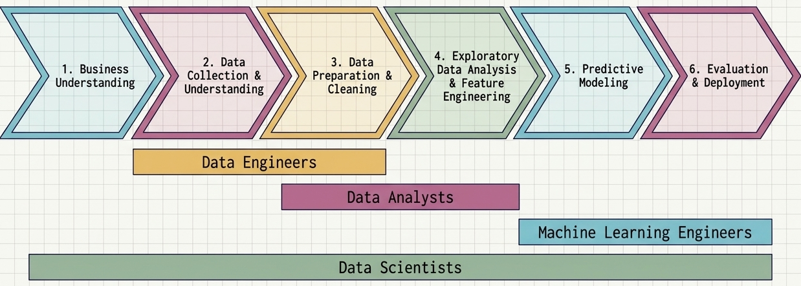
Knowledge Office
Data Science Lifecycle & Roles

Slide 26


Knowledge Office
Business Understanding & Data Collection
Business Understanding
Data Collection
Ask the right question, define the objective and success metric, and decide if data science is the right tool. Example: 'Predict monthly umbrella demand.'
Gather data from databases, files (CSV, Excel), APIs, web scraping, sensors and surveys. Check it is relevant, legal and sufficient.
Good questions first, data second: a vague goal gives a useless model.
Notes:
Example: a retailer wants to know how many umbrellas to stock before the monsoon.

Slide 27



Knowledge Office
Understanding Data Types
Structured
Semi-structured
Unstructured
Rows and columns: SQL tables, spreadsheets.
Tagged formats: JSON, XML, logs.
Text, images, audio, video.
Variable type | Meaning | Example
Numerical: continuous | Any value in a range | Temperature, price
Numerical: discrete | Countable whole numbers | Number of orders
Categorical: nominal | Categories, no order | City, colour
Categorical: ordinal | Ordered categories | Rating, grade
Notes:
Ask: which of these is 'rating 1-5'? (ordinal).

Slide 28




Knowledge Office
Data Quality & Data Cleaning
Missing values
Duplicates
Outliers
Inconsistent formats
Drop rows, or fill with mean, median, mode or a model.
Remove repeated records.
Detect with box plots or IQR; fix errors, keep real extremes.
Dates, units, spelling, wrong data types.
Quality dimensions: accuracy, completeness, consistency, validity, timeliness, uniqueness
Rule: garbage in, garbage out
Notes:
Show a date column with mixed formats (12/03/2025, 3 Dec 2025, 2025-12-03) and ask how to fix it.

Slide 29


Knowledge Office
Data Preprocessing
Encoding
Scaling
Feature engineering
Train / test split
Turn categories into numbers: label or one-hot encoding.
Normalization or standardization so features share a scale.
Create useful features, e.g. month from a date.
Hold out data (e.g. 80/20) to test on unseen cases.
Tip: split first, then fit scalers on training data only (avoids data leakage).
Notes:
Preprocessing makes data model-ready. Do the train/test split BEFORE fitting scalers to avoid leakage.

Slide 30
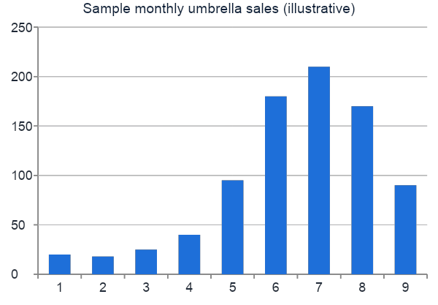
Knowledge Office
Exploratory Data Analysis (EDA)
Summary statistics: mean, median, spread
Visualize: histograms, box plots, scatter plots
Correlation: which features relate to the target?
Spot patterns, trends, outliers
Form hypotheses to test
Notes:
Chart values are illustrative sample data for the umbrella example, not real figures.

Slide 31
Knowledge Office
Features, Target & Prediction
Area (sq ft) | Bedrooms | Location | Price (target)
1000 | 2 | City A | 40 L
1500 | 3 | City B | 65 L
1200 | 2 | City A | ? (predict)
Features (X)
Target (y)
Prediction
Input columns used to learn.
The value we want to predict.
Model's estimate for unseen rows.
Notes:
Features = inputs (X). Target = what we predict (y). Prediction = model output for new data.

Slide 32


Knowledge Office
Model Building & Evaluation
Model building
Regression metrics
Classification metrics
Choose an algorithm (regression, classification, clustering), train on training data.
MAE, RMSE, R-squared: how close predictions are.
Accuracy, precision, recall, F1, confusion matrix.
Overfitting: memorizes training data, fails on new data. Underfitting: too simple to learn the pattern
Use cross-validation and test data for an honest score
Notes:
Accuracy alone misleads on imbalanced data (e.g. 1% fraud). Use precision, recall and F1.

Slide 33

Knowledge Office
Deployment, Monitoring & Recap
Deployment
Monitoring
Retrain
Serve the model via an API, app or dashboard.
Track accuracy, data drift, latency, errors.
Update the model as data changes.
Recap: Question -> Collect -> Clean -> Explore -> Model -> Evaluate -> Deploy -> Monitor -> repeat
Quick check: what is the target in the house-price example? Why split train and test?
Notes:
Models decay: data drift means retraining. Close with the questions on the right.

Slide 34

Knowledge Office
What is Generative AI?
Generative AI creates new content (text, images, audio, code, video) based on learned patterns. It uses Large Language Models (LLMs) and foundation models.
Examples:
ChatGPT
DALL-E
Gemini
Copilot
Stable Diffusion

Slide 35
Knowledge Office
How Generative AI Works (Simplified)
The simplified workflow of Generative AI:
1. Large Dataset
2. Foundation Model (LLM)
4. Generated Output
3. Prompt (Input)

Slide 36
Knowledge Office
Introduction to Generative AI & Foundation Models
DISCRIMINATIVE PARADIGM
Traditional AI
Classifies or predicts based on existing patterns and historical datasets.
TECHNICAL ARCHITECTURE
Core Technologies
Driven by advanced deep learning systems trained on massive, broad datasets:
• Foundation Models
• Large Language Models (LLMs)
• Diffusion Models
• Transformer Architectures
GENERATIVE PARADIGM
Generative AI
Creates novel content across multiple modalities, including text, code, images, audio, and video.

Slide 37
Knowledge Office
What GenAI can and cannot do
Strong: drafting, summarizing, coding help, translation, brainstorming
Weak: precise math, current events (without search), fact guarantees
Hallucination: fluent but wrong answers; always verify
Bias and privacy risks come from training data
Notes:
Show one live hallucination example if possible.

Slide 38



Knowledge Office
Industry Use Cases
Travel
Healthcare
Sales & Marketing
Dynamic pricing, flight-delay prediction.
Disease prediction, drug effectiveness.
Demand forecasting, upselling, churn, lifetime value.
Credit & Insurance
Social media
Automation
Claims prediction, fraud and risk detection.
Sentiment analysis, digital marketing.
Self-driving cars, pilotless drones.
Notes:
Use the earlier sector mind-map: Travel, Healthcare, Sales, Credit & Insurance, Marketing, Social Media, Automation.

Slide 39
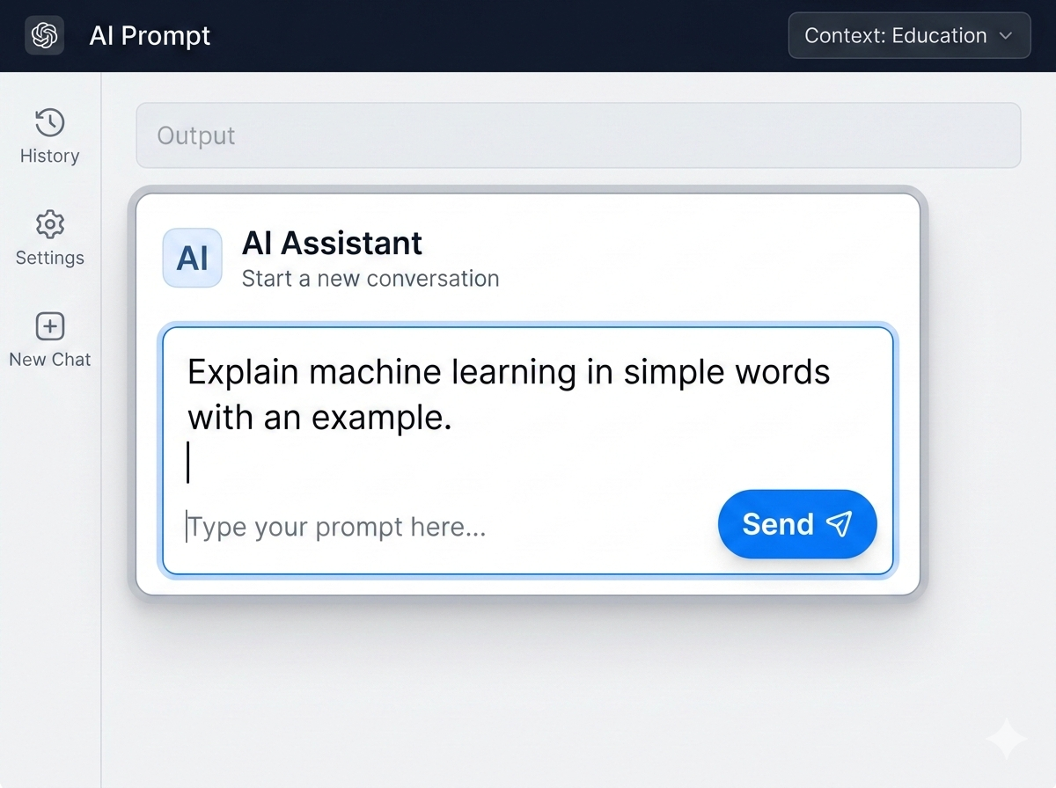
Knowledge Office
Prompt Engineering
Best practices for Prompt Engineering:
Clearly define the task
Provide context
Give examples (if needed)
Specify output format
Iterate and refine

Slide 40
Knowledge Office
Trends, Opportunities and Challenges
Trends
LLMs and multimodal AI
AI agents
Edge AI
Industry-specific AI
Responsible AI
Opportunities
New products and services
Increased productivity
Personalized experiences
Jobs and skill development
Challenges
Bias and fairness
Data privacy
Misinformation
Job displacement
Ethical use

Slide 41


Knowledge Office
Careers in Data, ML & AI
Data Scientist / Analyst
Data Engineer / Architect
ML / AI Engineer
Insights, dashboards, prediction.
Pipelines and storage.
Build and deploy models.
NLP Scientist
BI Developer
Cybersecurity Analyst
Language systems and chatbots.
Business dashboards.
Protect data and models.

Slide 42
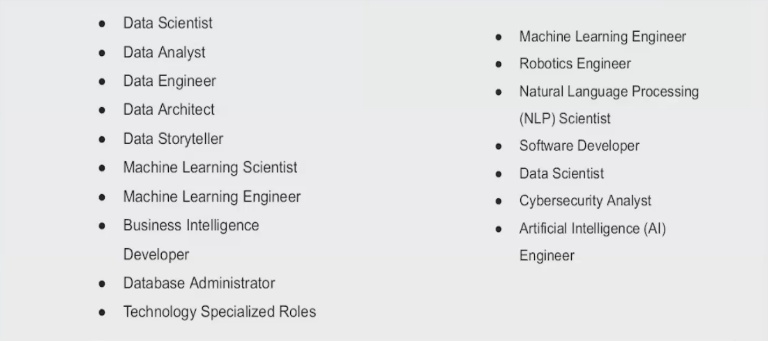
Knowledge Office
More Career Roles in AI & Data

